Slide 1



Map of Content
to
Meta-Learning
aka a map to learn how to learn
”learning to learn”
@davzoku/meta-learning-moc

Slide 2

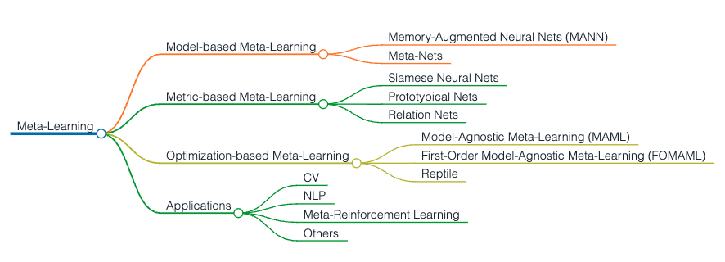
Map of Content

Slide 3
Map of Resources
Stanford CS 330 Deep Multi-Task and Meta Learning (For Depth)
Machine Learning Course (National Taiwan University), in Mandarin
(For Breadth)
Meta-Learning: Theory, Algorithms and Applications
Meta-Learning in PyTorch Youtube Playlist
Meta Learning for Natural Language Processing: A Survey

Slide 4

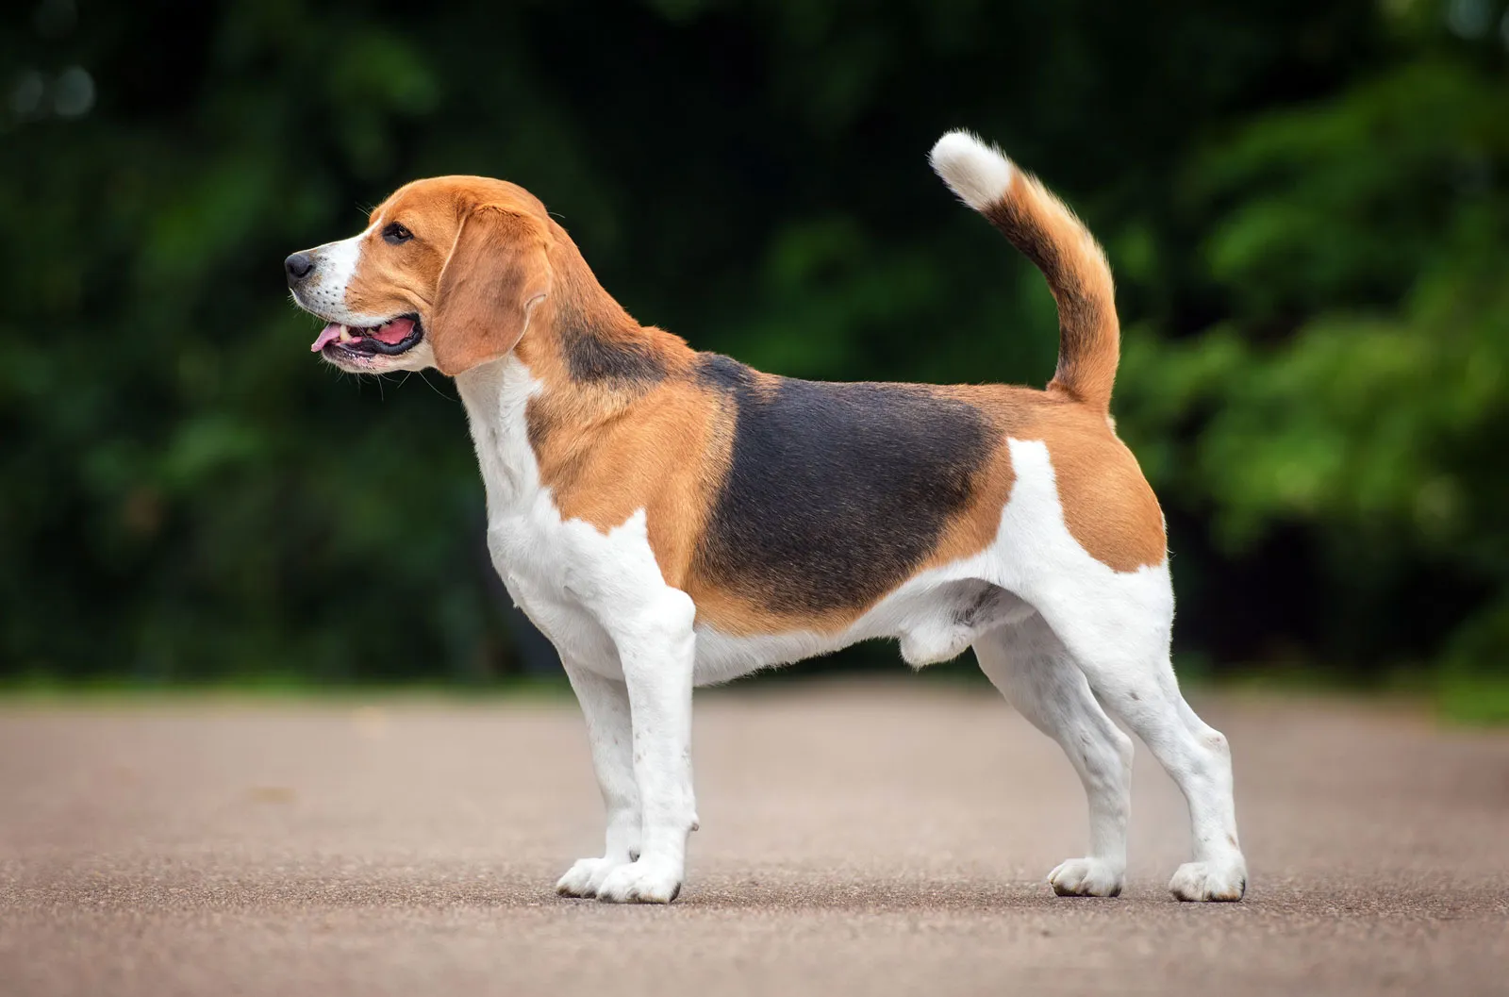
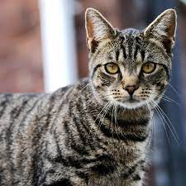
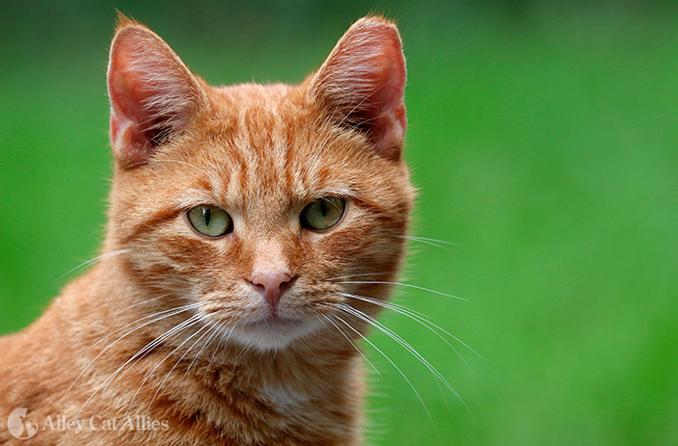


Machine Learning & Meta Learning
Machine Learning ≈ find a function f
Dog-Cat Classification
𝑓_{θ} ( ) = “cat”
Meta Learning ≈ find a function F that finds a function f
Training Examples
Learning Algorithm
𝐹_{φ} ( ) = 𝑓
Dog Cat Cat Dog Cat
Adapted from https://youtu.be/xoastiYx9JU?t=1745

Slide 5
Formulating a Meta Learning Problem
Given data from 𝒯₁ , …, 𝒯 _{n} , solve new task 𝒯_{test} more quickly / proﬁciently / stably
Key assumption: meta-training tasks and meta-test task drawn i.i.d. from same task distribution
𝒯₁ , …, 𝒯_{n} ∼ p(𝒯), 𝒯 _{test} ∼ p(𝒯)
Tasks must share structure.
Sample Tasks (in NLP context):
The tasks belong to the same NLP problem.
All 𝒯_{n} are QA tasks but different corpora
Tasks that belong to various NLP problems
Adapted from https://youtu.be/cjTs7lH5eUs?t=53

Slide 6
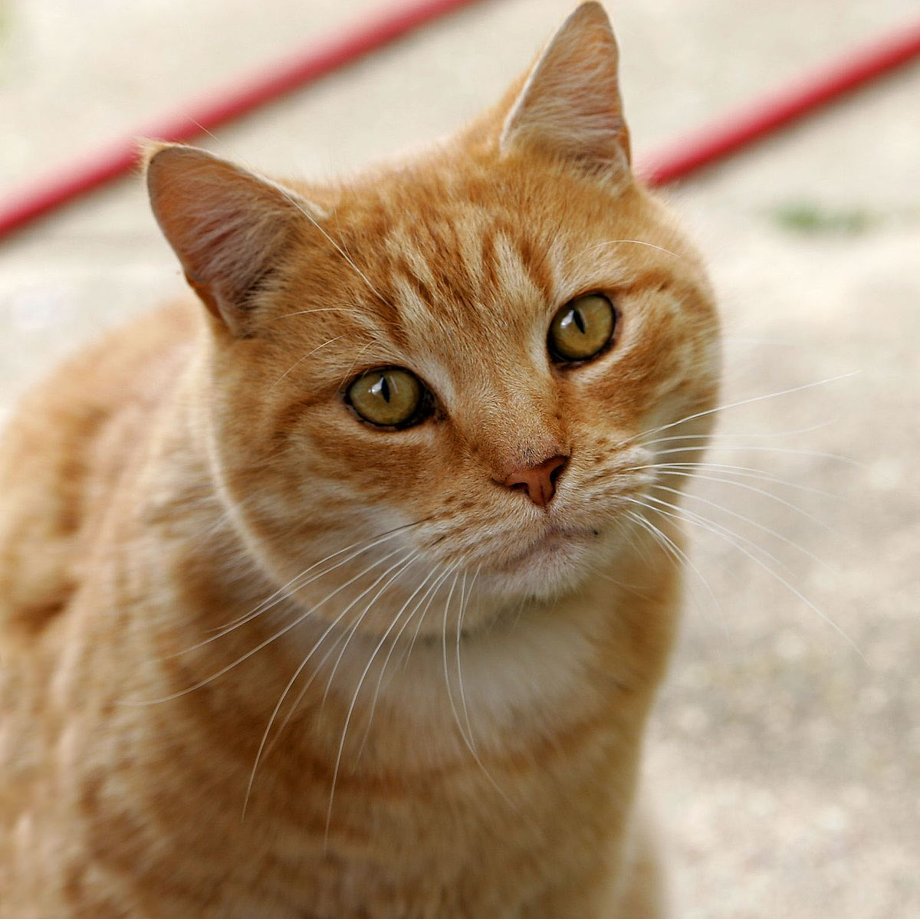
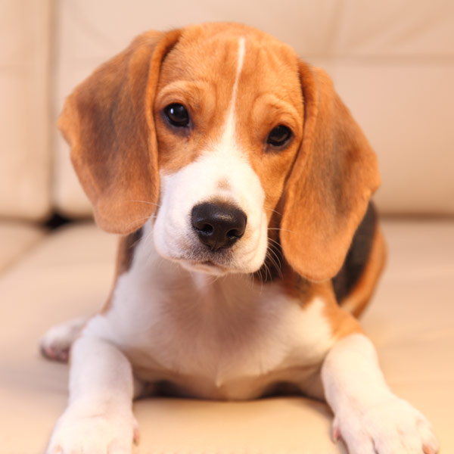



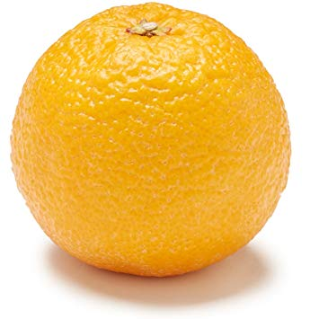
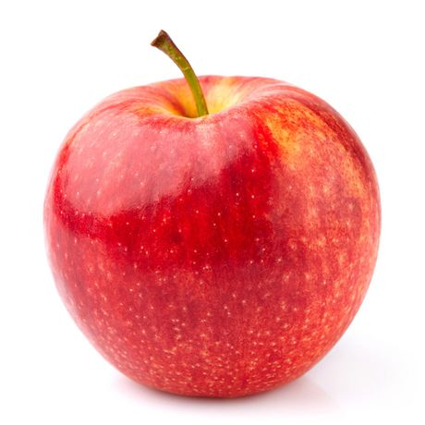
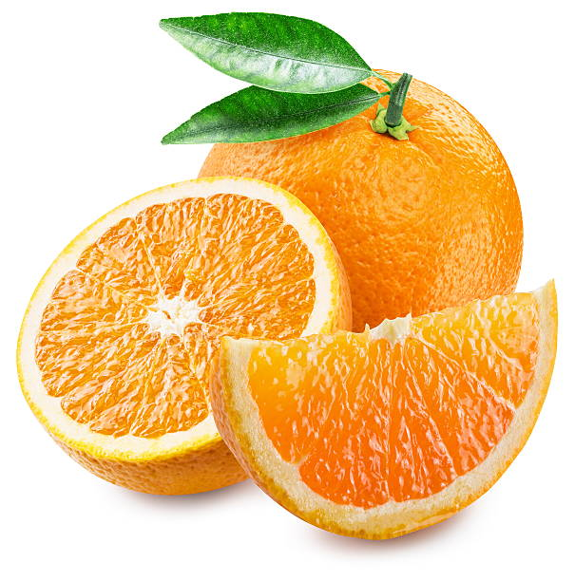
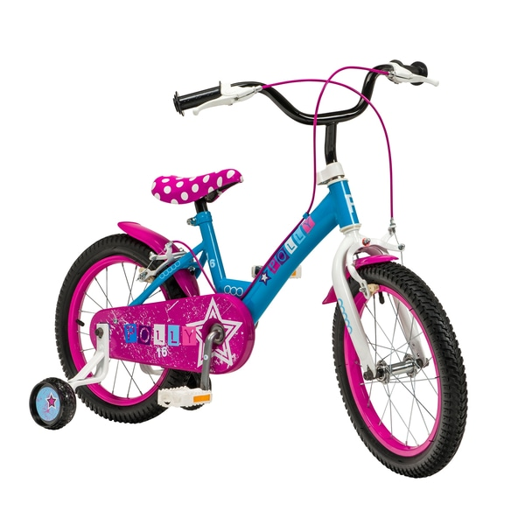
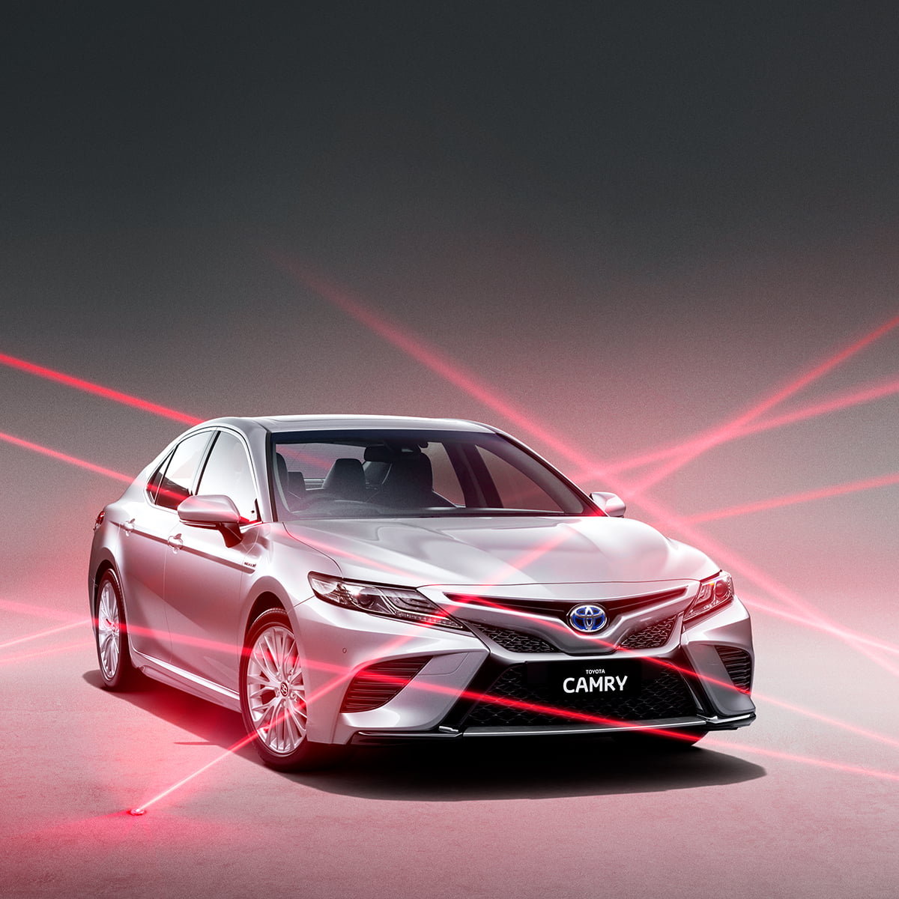
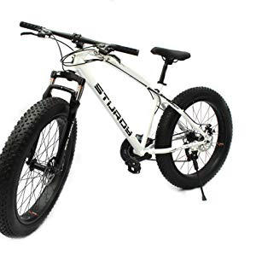

Machine Learning
Terminology
cat
dog
cat
dog
Train
Test
Support set
Query set
Task 1
Train
Test
Training
Tasks
cat
dog
cat
dog
Task 2
Train
Test
apple
orange
apple
orange
Sometimes you need validation tasks
Testing Tasks
Train
Test
bike
car
bike
car
Adapted from https://www.youtube.com/watch?v=EkAqYbpCYAc

Slide 7
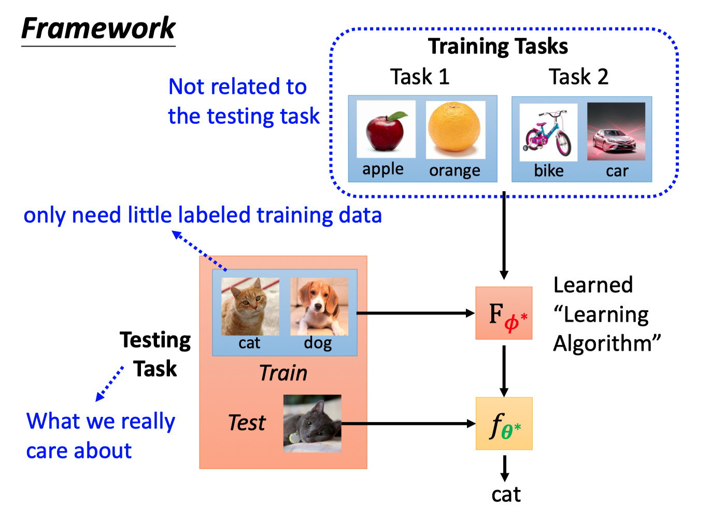
Framework
Adapted from https://www.youtube.com/watch?v=xoastiYx9JU

Slide 8
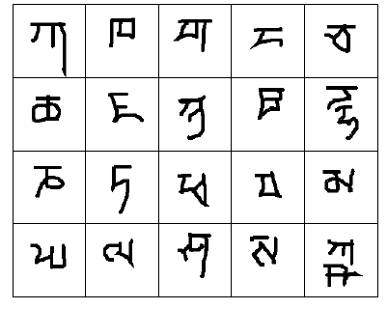
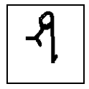
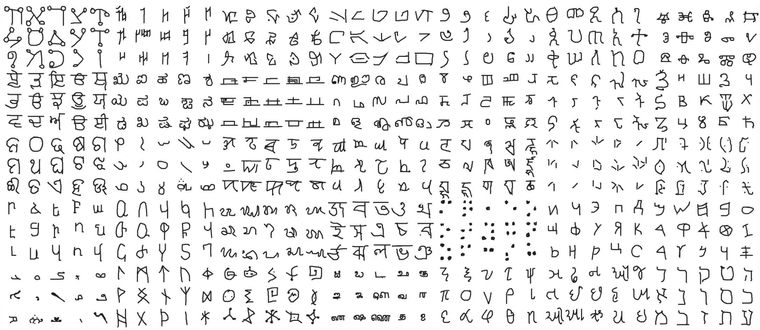
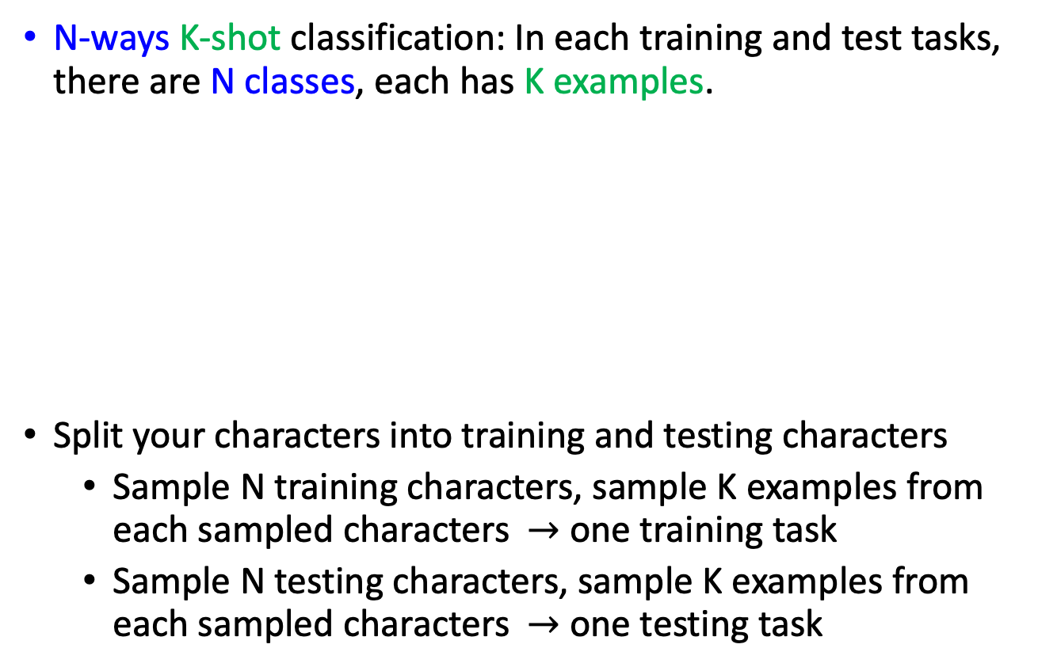
Few shot Classification
N-ways K-shot classification: In each training and test tasks, there are N classes, each has K examples.
Split your characters into training and testing characters
Sample N training characters, sample K examples from each sampled characters $→$ one training task
Sample N testing characters, sample K examples from each sampled characters $→$ one testing task
20 ways
1 shot
Testing set
(Query set)
Each character represents a class
Training set
(Support set)
Omniglot dataset:
1623 characters
Each has 20 examples
Adapted from https://www.youtube.com/watch?v=vUwOA3SNb_E

Slide 9

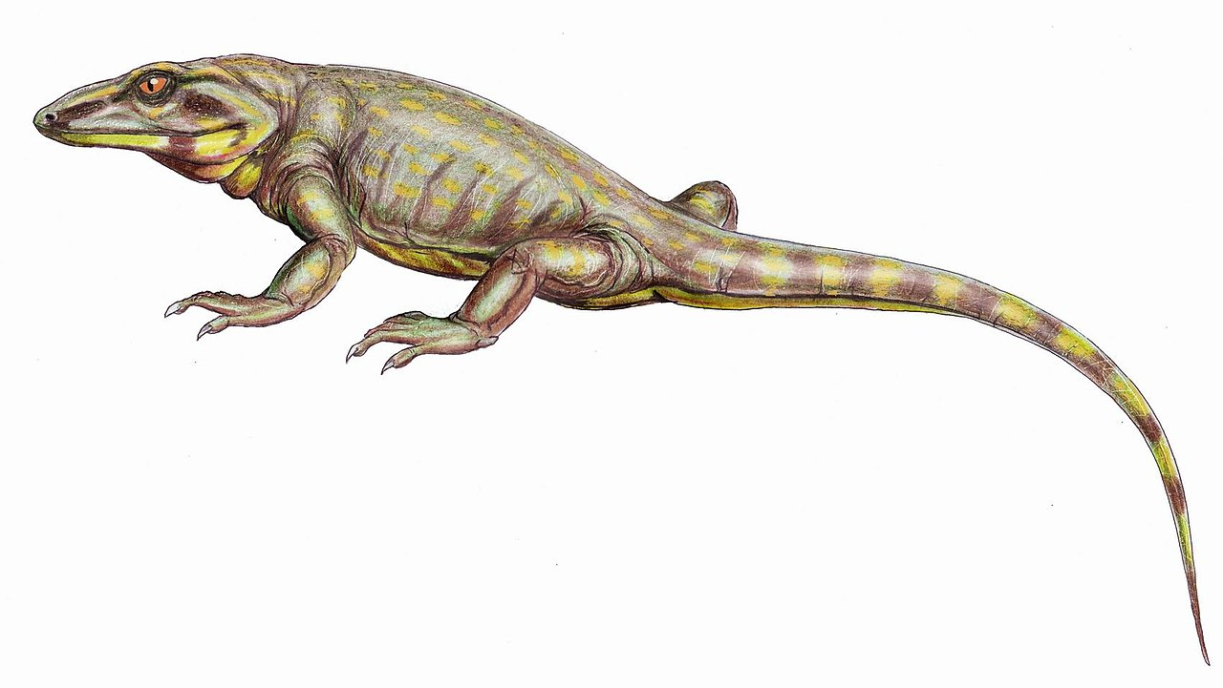
Optimization-Based Meta-Learning
Learning to Initialize
MAML
Chelsea Finn, Pieter Abbeel, and Sergey Levine, “Model-Agnostic Meta-Learning for Fast Adaptation of Deep Networks”, ICML, 2017
Reptile
Alex Nichol, Joshua Achiam, John Schulman, On First-Order Meta-Learning Algorithms, arXiv, 2018
Adapted from https://www.youtube.com/watch?v=vUwOA3SNb_E

Slide 10
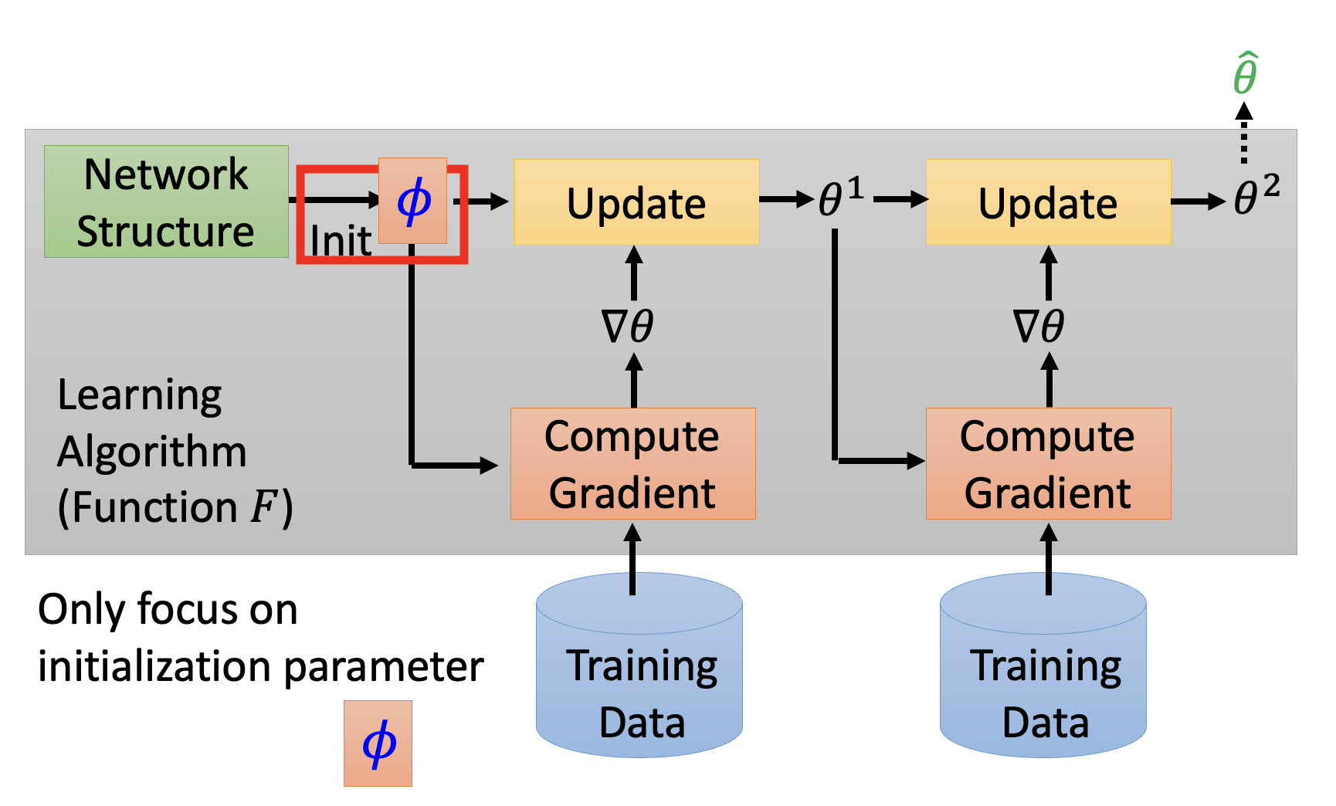
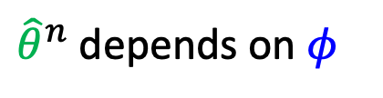
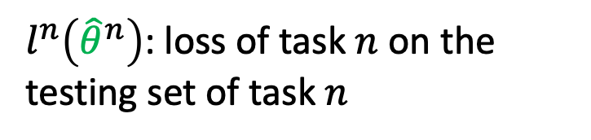
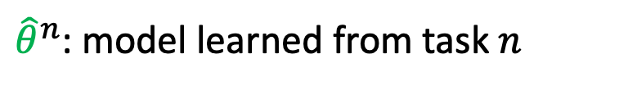
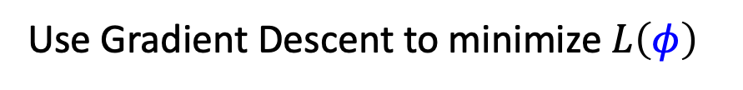
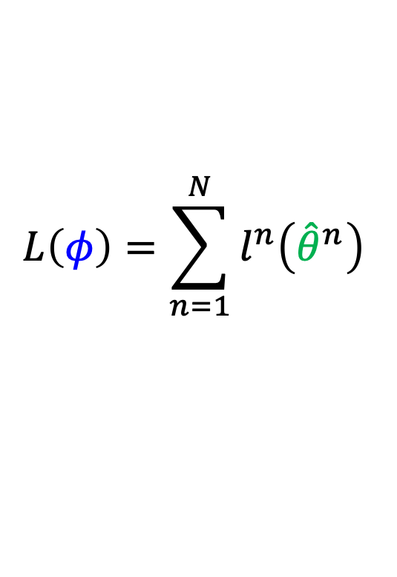
${\hat{θ}}^{n}$: model learned from task $n$
MAML
${\hat{θ}}^{n}$ depends on $φ$
Loss Function:
$l^{n}\left({\hat{θ}}^{n}\right)$: loss of task $n$ on the testing set of task $n$
$$L\left(φ\right)=\sum_{n=1}^{N}{l^{n}\left({\hat{θ}}^{n}\right) }$$
Use Gradient Descent to minimize $L\left(φ\right)$
$$φ←φ−η∇_{φ}L\left(φ\right)$$
Adapted from https://www.youtube.com/watch?v=vUwOA3SNb_E

Slide 11
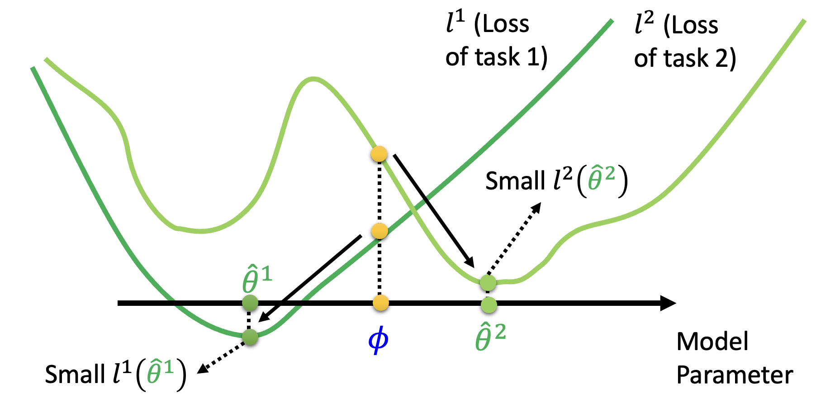
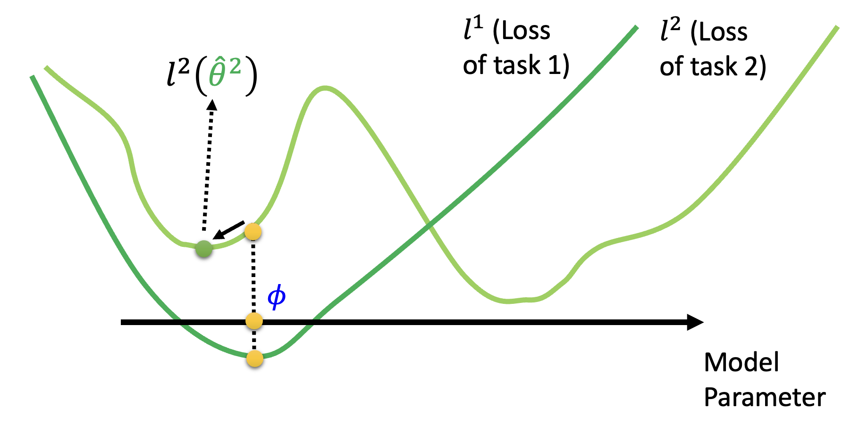
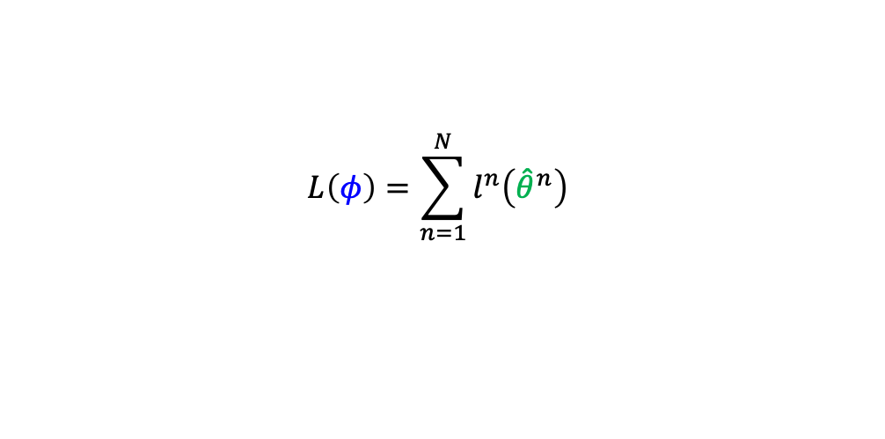
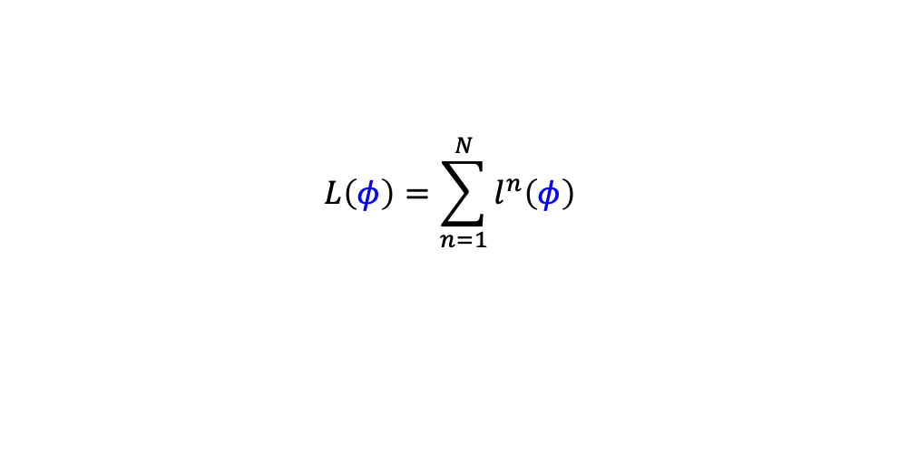
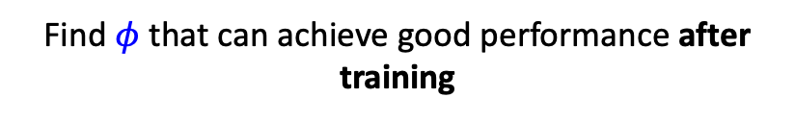
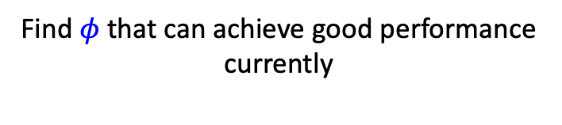
MAML vs Pre-training
$$L\left(φ\right)=\sum_{n=1}^{N}{l^{n}\left({\hat{θ}}^{n}\right) }$$
$$L\left(φ\right)=\sum_{n=1}^{N}{l^{n}\left(φ\right) }$$
MAML
Pre-training
Find $φ$ that can achieve good performance after training
Find $φ$ that can achieve good performance currently
Adapted from https://www.youtube.com/watch?v=vUwOA3SNb_E

Slide 12
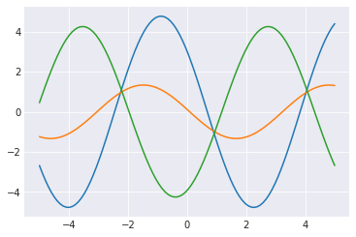
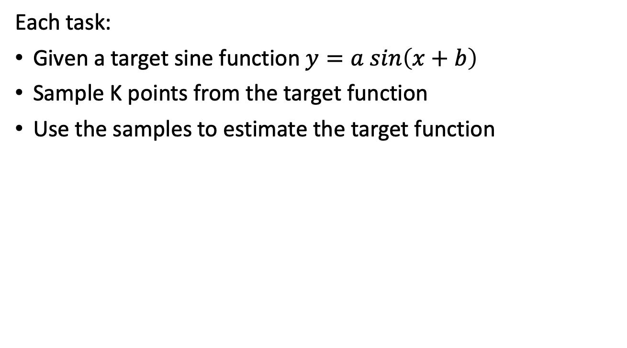
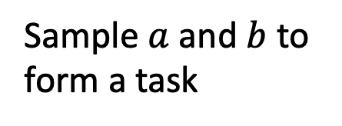
MAML: Toy Model
Each task:
Given a target sine function $y=a sin\left(x+b\right)$
Sample K points from the target function
Use the samples to estimate the target function
Sample $a$ and $b$ to form a task
Adapted from https://www.youtube.com/watch?v=vUwOA3SNb_E

Slide 13
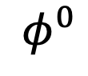
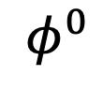
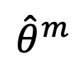
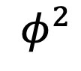
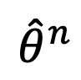
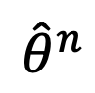
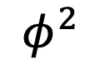
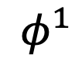
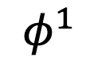
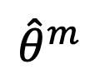
MAML
Sample a training task m
$${\hat{θ}}^{m}$$
Model Pre-training
$${\hat{θ}}^{m}$$
$$φ^{0}$$
$$φ^{1}$$
$$φ^{1}$$
$$φ^{0}$$
$${\hat{θ}}^{n}$$
$${\hat{θ}}^{n}$$
$$φ^{2}$$
$$φ^{2}$$
Sample a training task n
Adapted from https://www.youtube.com/watch?v=vUwOA3SNb_E

Slide 14
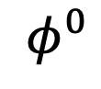
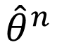
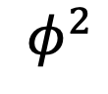
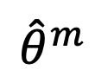
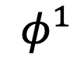
Reptile
Sample a training task m
$$φ^{0}$$
$$φ^{1}$$
$${\hat{θ}}^{m}$$
$$φ^{2}$$
Sample a training task n
$${\hat{θ}}^{n}$$
Adapted from https://www.youtube.com/watch?v=vUwOA3SNb_E

Slide 15
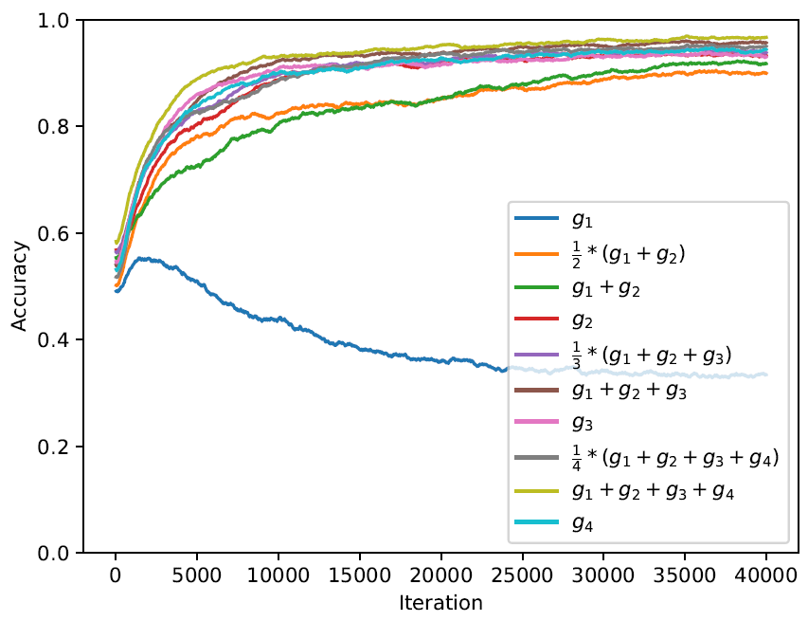
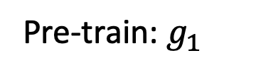





Reptile
Pre-train: $g_{1}$
$$g_{1}$$
$$g_{2}$$
$$φ$$
Reptile: $g_{1}+g_{2}$
MAML: $g_{2}$
(simplified)
Pre-train
Adapted from https://www.youtube.com/watch?v=vUwOA3SNb_E

Slide 16





Model-Based Meta-Learning
Meta-Learning as a sequence-to-sequence problem
Other External
Memory Mechanisms
LSTMs or Neural Turing Machine
Convolutions + Attention
A Simple Neural Attentive
Meta-Learner, 2018
From Meta-Learning: Theory, Algorithms and Applications Chapter 2
Adapted from https://youtu.be/cjTs7lH5eUs?t=3865

Slide 17

Metric-Based Meta-Learning
Learning to Compare
learns similarity or dissimilarity measures using distance measures
to tackle tasks such as classification or few-shot learning
Adapted from https://youtu.be/Q68Eh-wm1Ts?t=1441

Slide 18


Metric-Based Meta-Learning
Siamese Network
CNN
embedding
Train
Same
share
Similarity
score
CNN
Yes
Large score
embedding
Small score
No
Test
Adapted from https://www.youtube.com/watch?v=yyKaACh_j3M

Slide 19











Metric-Based Meta-Learning
Prototypical Network
$$s_{1}$$
$$s_{2}$$
$$s_{3}$$
$$s_{4}$$
$$s_{5}$$
CNN
CNN
CNN
CNN
CNN
CNN
= similarity
Adapted from https://www.youtube.com/watch?v=semSxPP2Yzg

Slide 20





Metric-Based Meta-Learning
Matching Network
$$s_{1}$$
$$s_{2}$$
$$s_{3}$$
$$s_{4}$$
$$s_{5}$$
CNN
Bidirectional LSTM
= similarity
Adapted from https://www.youtube.com/watch?v=semSxPP2Yzg

Slide 21

Metric-Based Meta-Learning
Relation Network
Adapted from https://www.youtube.com/watch?v=semSxPP2Yzg

Slide 22

Application: Optimizer
Learning to learn by gradient descent by gradient descent, 2016
Right: The LSTM optimizer was trained on an MLP with sigmoid activations.

Slide 23

Application: Neural Architectural Search (NAS)
NAS as a sequence-to-sequence problem
Neural Architecture Search with Reinforcement Learning, 2017

Slide 24


Application: Neural Architectural Search (NAS)
Gradient-Based NAS for discovering high-performance CNN for image classification & RNN for language modelling
DARTS: Differentiable Architectural Search, 2019

Slide 25


Application: Data Augmentation
DADA: Differentiable Automatic Data Augmentation, 2020
AA: AutoAugment
PBA: Population Based Augmentation
Fast AA: Fast AutoAugment
DADA relaxes the discrete DA policy selection to a
differentiable optimization problem via Gumbel-Softmax.

Slide 26
Advanced Topics

Slide 27
Unsupervised / Semi-Supervised Meta-Learning
Given unlabeled dataset(s) → Propose tasks → Run meta-learning
Goal:
Automatically construct tasks from unlabeled data.
For more info:
Lecture: watch https://youtu.be/4z3ijI9QacE?t=2929

Slide 28
Bayesian Meta-Learning
Incorporating Bayesian methods and probabilistic reasoning with meta-learning.
Goal:
Explictly model and reason about uncertainty in the meta-learning process.
For more info:
- Lecture: watch https://www.youtube.com/watch?v=-y3ufzjgmlY
Applications in CV: see Meta-Learning: Theory, Algorithms and Applications: Section 5.2.13
Applications in NLP: see Meta-Learning: Theory, Algorithms and Applications: Section 6.6.3

Slide 29

Meta Reinforcement Learning
Learning to Explore
Goal:
Given a small amount of experience, learn to solve the test task in meta test time;
by learning how to learn many other task during meta train time
For more info:
Lecture: watch https://www.youtube.com/watch?v=gUutjhnc2Q4, https://www.youtube.com/watch?v=_KoLFz5BTWw, https://www.youtube.com/watch?v=VGLqzbsOSJY
see Meta-Learning: Theory, Algorithms and Applications: Chapter 7
From Meta Reinforcement Learning Adaptable Models & Policies, CS330, 2021

Slide 30
Meta Learning
and NLP

Slide 31

Meta-Learning and Self-Supervised Learning
Adapted from https://youtu.be/QNfymMRUg3M?t=87
Notes:
Similar and complementary

Slide 32

Meta-Learning and Self-Supervised Learning
MAML learns the initialization parameter 𝜙 by gradient descent
In other words, you need a set of initialization parameters to find the initialization parameter for your downstream architecture
BERT can serve as 𝜙
Adapted from https://youtu.be/QNfymMRUg3M?t=87

Slide 33


Meta-Learning and NLP
From Learning to Few-Shot Learn Across Diverse Natural Language Classification Tasks, 2020
LEOPARD model:
for learning new NLP classification tasks with k-examples and with different number of classes
From Meta Learning for Natural Language Processing: A Survey, 2022

Slide 34


Meta-Learning and NLP
Investigating Meta-Learning Algorithms
for Low-Resource Natural Language
Understanding Tasks, 2019
Multi-task learning is a base line of Meta-Learning
The SciTail dataset is an entailment dataset created from multiple-choice science exams and web sentences.

Slide 35
Q & A

